Slide 1
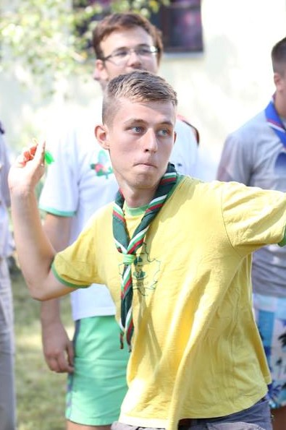
Serbian national Jamboree
Belgrade, 27. 7. – 5. 8. 2018.

Slide 2
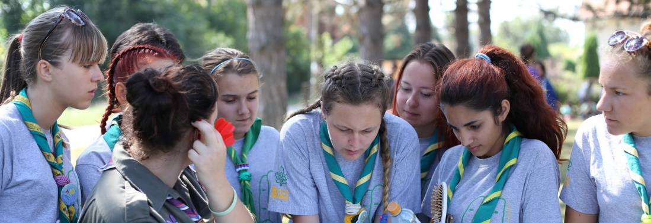
Scouting for all
10. Serbian National Jamboree
Belgrade 27.07 – 05.08.2018.
Ada Ciganlija
10 days packed with various exciting, challenging and unique activities that will help you meet other scouts, make friendships and explore the Serbian capital

Slide 3
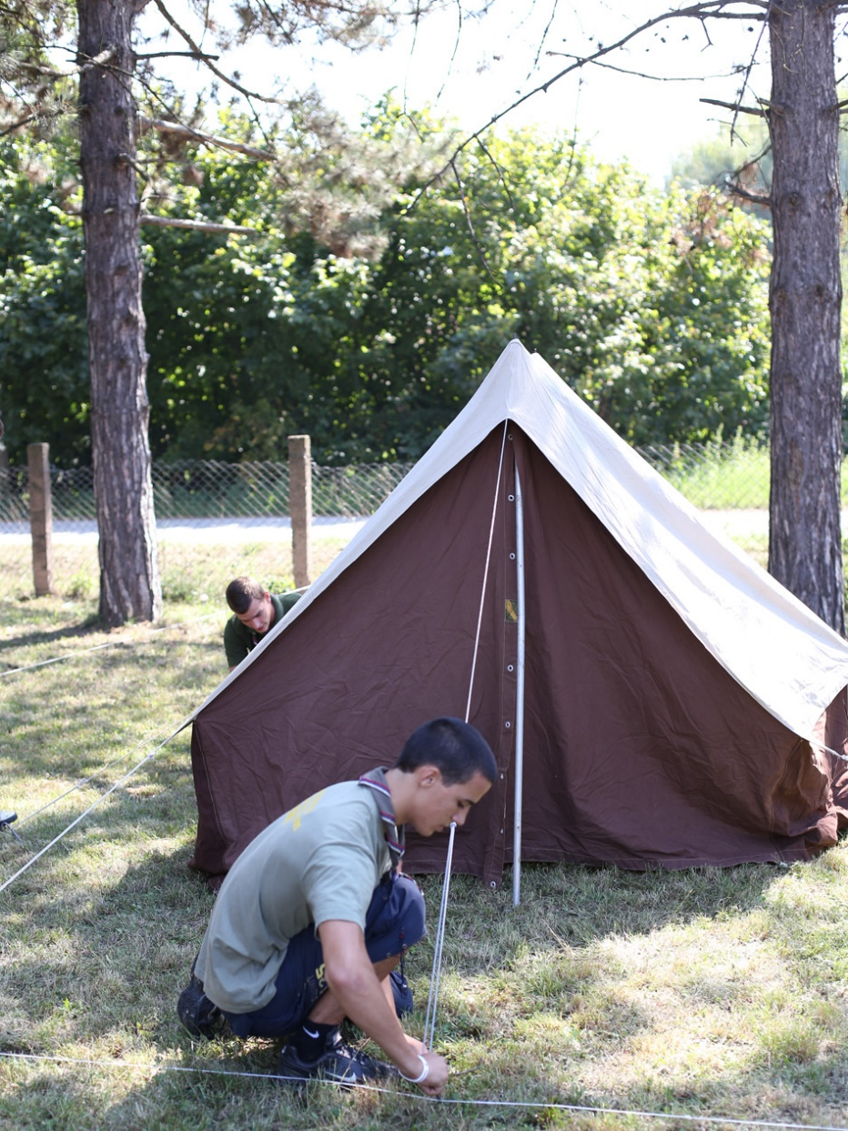
Program areas
Scouting for all
10. Smotra SIS
Theme - Scouting for all
Ropes and poles
Adventure day
Eureka
Time machine
World 2030
Scouts in action
Catch Cvorko
Bonus package
Field trip

Slide 4
Adventure
Scouting for all
10. Smotra SIS
day
Ropes and poles
What a camp would be like with no adventure? This module offers a chance to take part in different activities in and around water, such as raft building, rowing, swimming and an opportunity to experience some completely new challenging activities. After this, the word adventure would get a completely new meaning?
What can you make with some ropes and poles? Participants will have a chance to showcase their creativity, their knot tying and tool using skills, but to also learn about new techniques of using natural resources in everyday life. Who knows, this might be the place for future architects and designers?

Slide 5
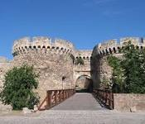
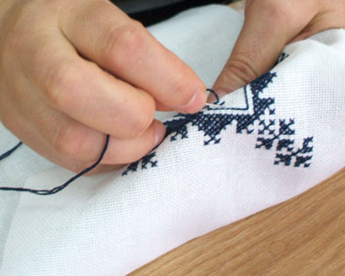
Time machine
Scouting for all
10. Smotra SIS
What was fashion like 200 years ago? How were weapons made then? What toys did children use to play with in the past? You will learn the answers to all these questions once you board a time machine and go back to different periods in Serbian history. The Time machine will take them to some unexpected places, such as underground tunnels or old houses, but will also bring them back to present and show them the hidden worlds of art.
History
Tradition
Sightseeing and exploration
Arts and crafts

Slide 6
Eureka
Belgrade 27.07 – 05.08.2018.
Our world is physics, chemistry and biology! If it weren’t for the great scientific discoveries, we would not have had electricity, internet, fireworks or modern medicine. But what makes all those possible and what are some of the future inventions? This module will give participants a chance to learn all that, to make experiments and become scientists for a day.

Slide 7
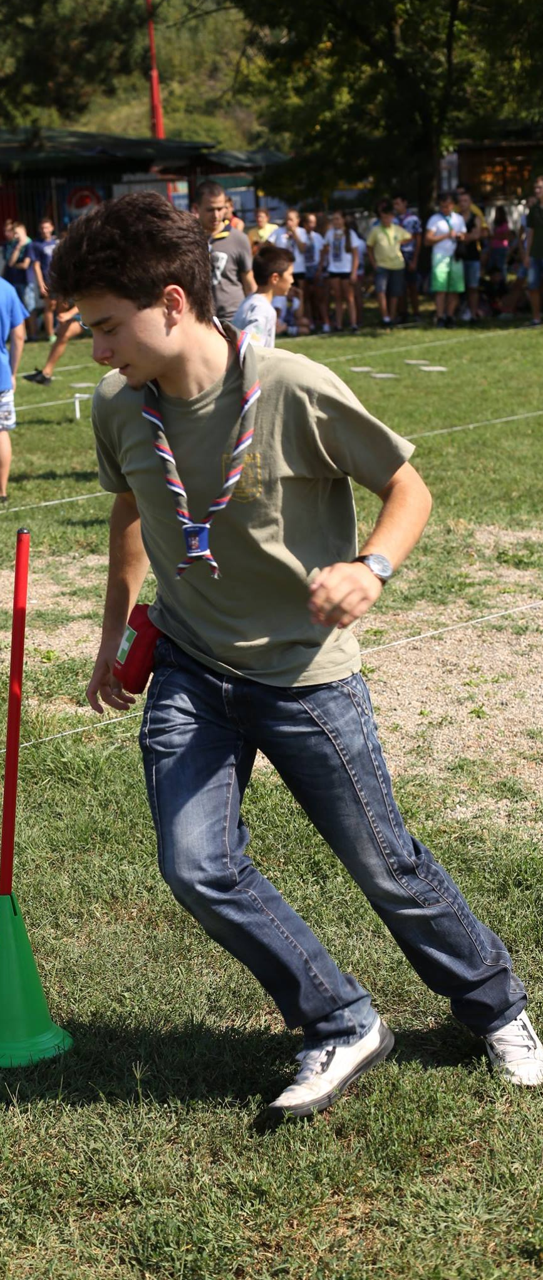
Scouts
Scouting for all
10. Smotra SIS
World 2030
In action
Creating a better world requires action. A good turn, no matter how small it is, can make a big difference. During this module, the participants will have a chance to contribute to the local community and do something nice for its members.
We have inherited this planet from our ancestors and we pass it on our children. The state it will be in depends entirely on us. Through this module, the participants will learn about strategies and opportunities for creating sustainable development, use of renewable energy sources and everyday things that can contribute to creating a cleaner and healthier planet and its conservation.

Slide 8
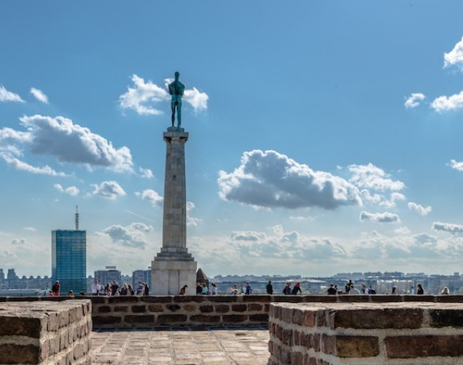
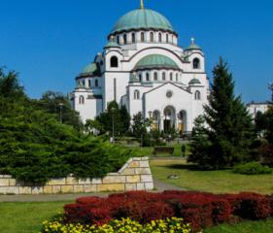
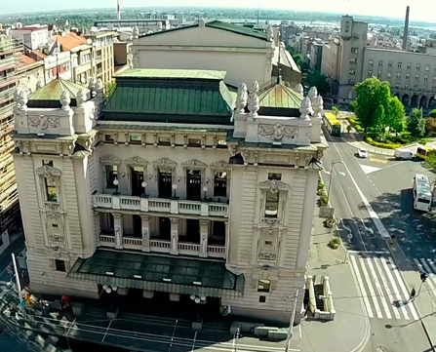
Catch Cvorko
Scouting for all
10. Smotra SIS
Cvrorko, the mascot of the camp, takes us on a city tour. However, since scouts like challenges, they will need to find their own way around the city. To get to know the capital of Serbia, participants will have to use their orienteering skills in an unfamiliar setting. Their will be rewarded by the beautiful sights that exist only in Belgrade.

Slide 9
Day
Scouting for all
10. Smotra SIS
Bonus Package
trip
One day will be a trip giving participants a chance to discover the area around Belgrade and some of the most important places and wonders of nature in this area.
This is not going to be only a sightseeing tour, because each place offers a unique activity.
Nothing is left to chance at Smotra. Each moment can be used in a special and unique way. Bonus package offers exactly that through a series of different activities that participants can visit during their free time. There are no rules here, everything is possible in the bonus package.

Slide 10
Scouting for all
10. Serbian National Jamboree
Belgrade 27.07 – 05.08.2018.
Ada Ciganlija
An Island in the Sava river, a popular leisure area situated on the outskirts of Belgrade. The program will include traditional scouting activities, such as pionering and camping skills, but will also offer an oportunity for exploring the city and its rich cultural heritage. In addition, scout units from Serbia will be offering possibilities for home hospitality before or after ’’Smotra“.

